Slide 1
Module-5

Slide 2
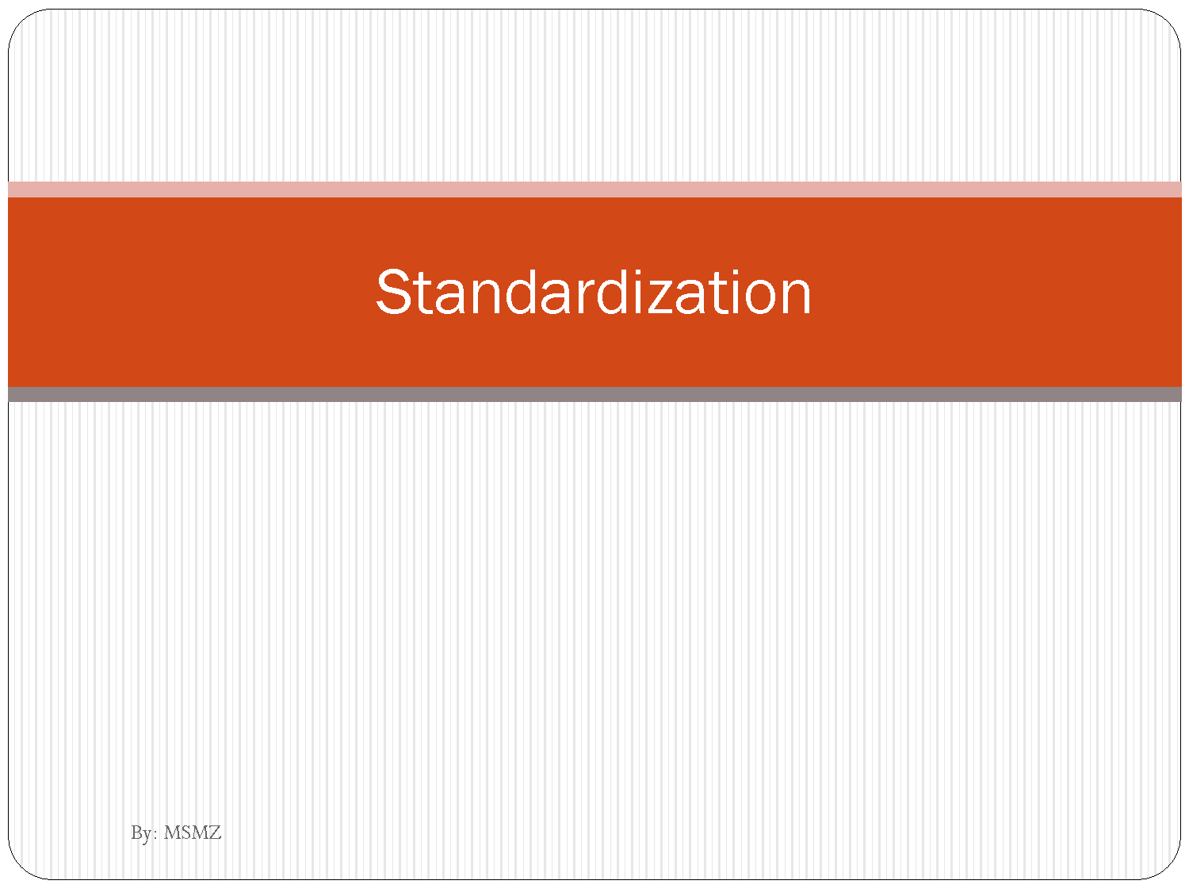

Slide 3
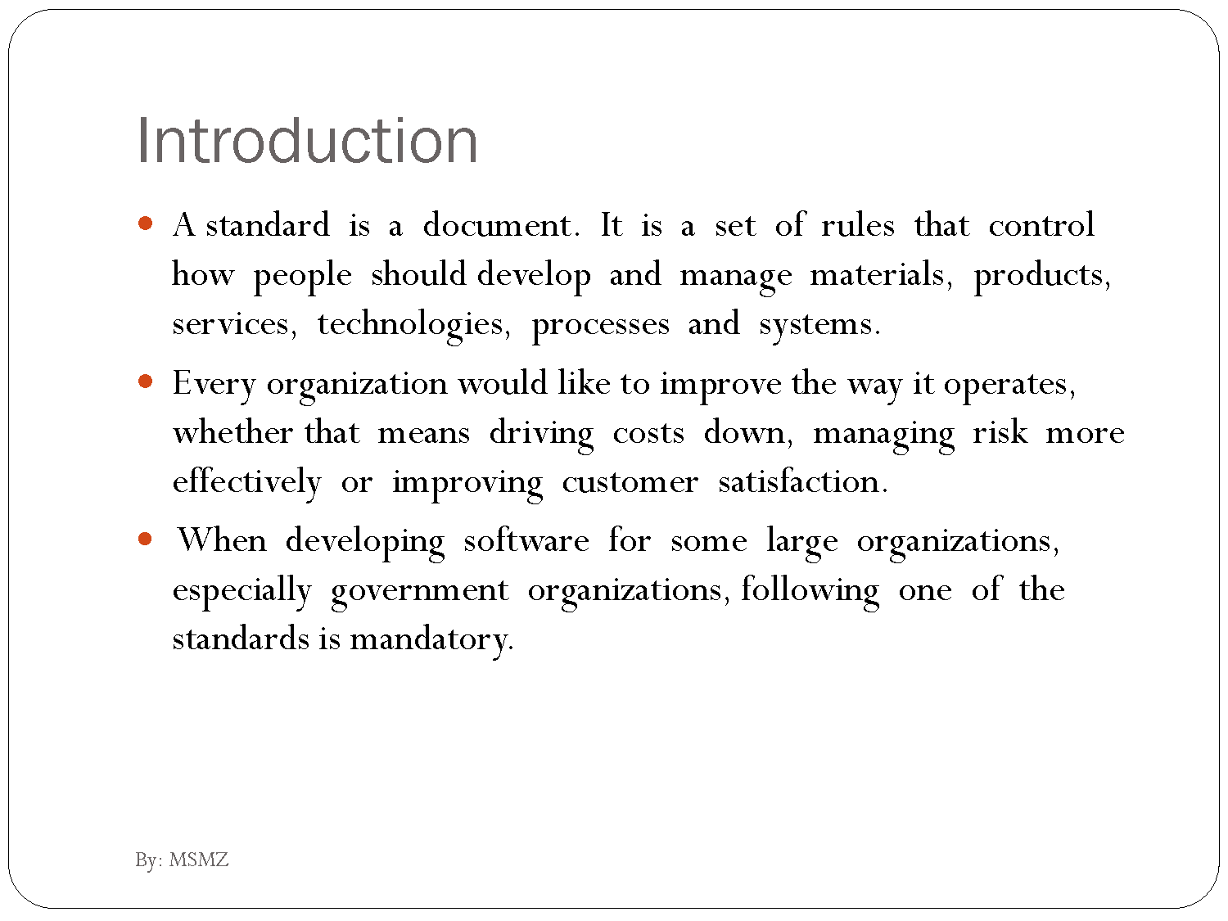

Slide 4
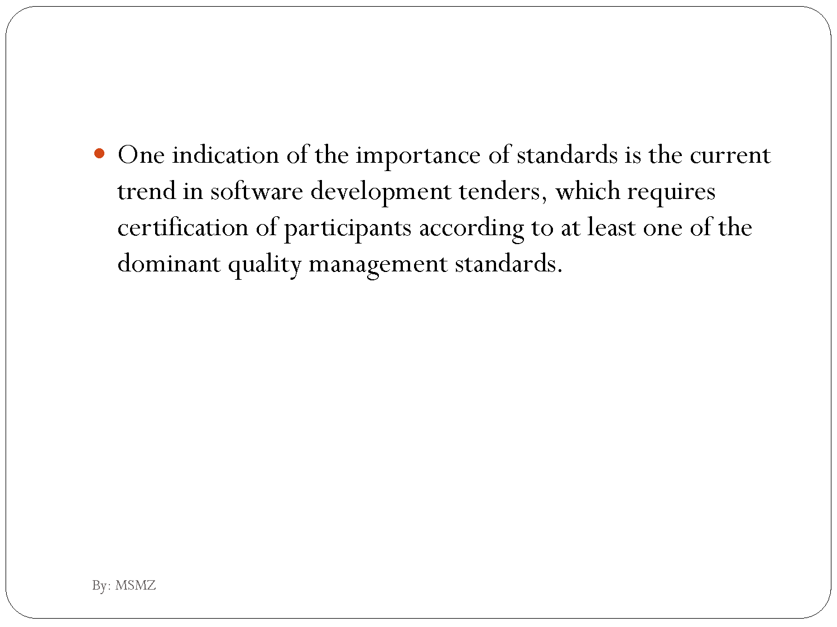

Slide 5
Organizations involved in SQA Standards Development
Most prominent developers of SQA standards:
IEEE (Institute of Electric and Electronic Engineers) Computer Society
ISO (International Standards Organization)
DOD (US Department of Defense)
ANSI (American National Standards Institute)
IEC (International Electrotechnical Commission)
EIA (Electronic Industries Association)

Slide 6
Software quality assurance standards
Several standards that are related to software quality assurance are available. Examples are:
IEEE: Institute of Electrical and Electronics Engineers Computer Society
Software Engineering Standards Committee (e.g.
IEEE Std 1228-1994 Standard for Software Safety Plans)
Quality measurement: IEEE Std 1061-1992 Standard for Software Quality Metrics Methodology
ISO: International Organization for Standardization (e.g.
ISO/IEC 2382-7:1989 Vocabulary-Part 7: Computer Programming)
ISO 9000-3 Quality Management and Quality Assurance Standards - Part 3: Guidelines for the application of 9001 to the development, supply, installation and maintenance of computer software
DOD: Department of deffence – USA
CMMi: Capability maturity level
IEC: International Electrotechnical Commission (e.g. IEC 61508
Functional Safety - Safety-Related Systems)

Slide 7
Software quality assurance standards by tasks
General project management: IEE Std 1058.1-1987
Standard for Software Project Management Plans
Producing plans: IEEE Std 1059-1993 Guide for
Software Verification and Validation Plans
Lifecycle: ISO/IEC WD 15288
System Life Cycle Processes
Requirements: IEEE Std 1233-1996
Guide for developing System Requirements Specifications

Slide 8
Software quality assurance standards by tasks
Maintenance: IEEE Std 1219-1992
Standard for Software Maintenance
Productivity: IEE Std 1045-1992
Standard for Software Productivity Metrics

Slide 9
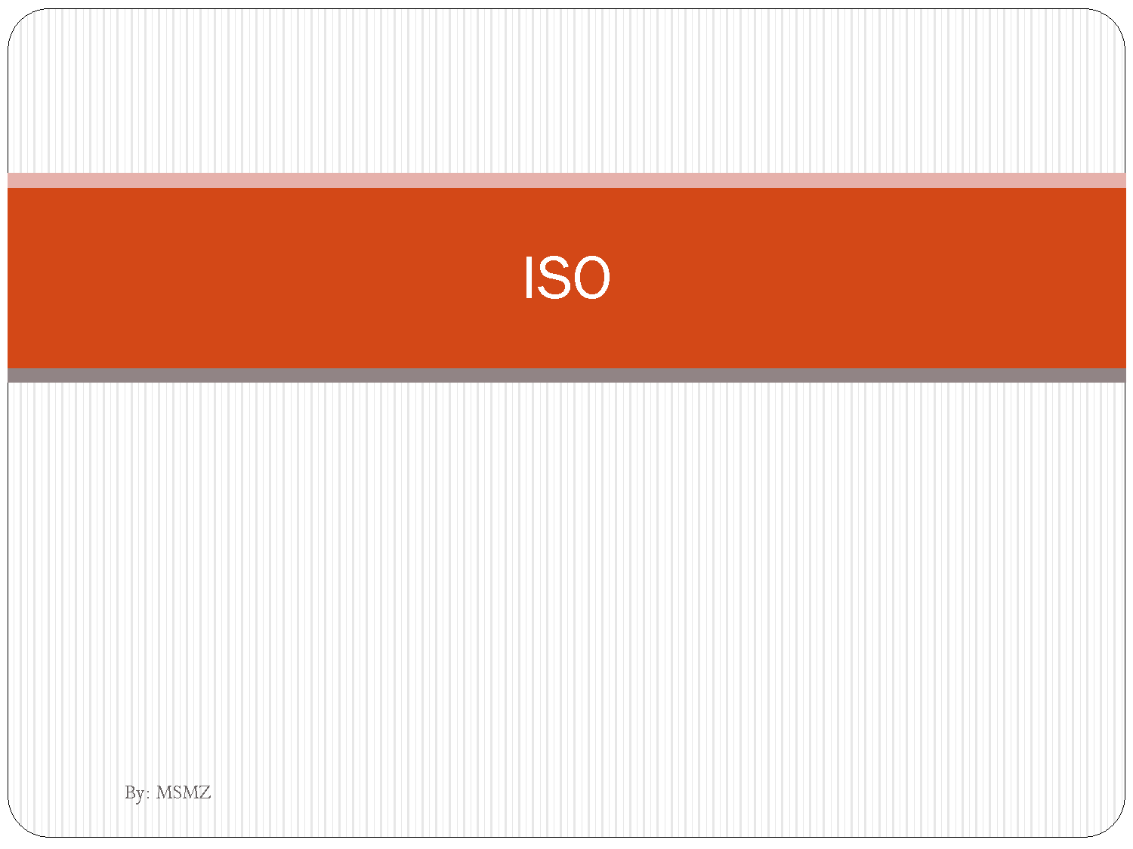

Slide 10
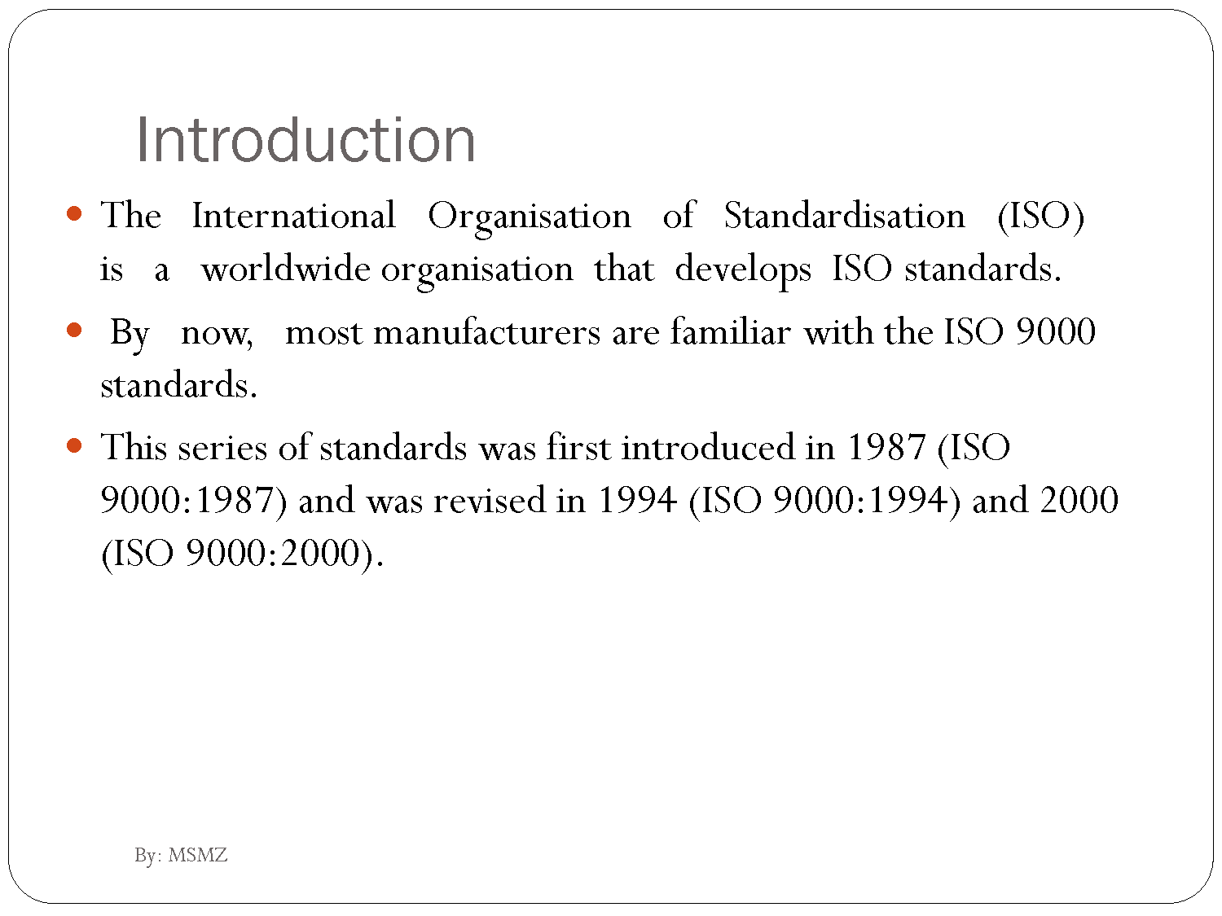

Slide 11
Administration of ISO
Membership of ISO is open to national standards institutes or similar organizations most representative of standardization in their country
Member bodies
Correspondent members
Subscriber members
individuals or enterprises are not eligible for membership
ISO's national members pay subscriptions that meet the operational cost of ISO's Central Secretariat
ISO standards are developed by technical committees comprising experts on loan from the industrial, technical and business sectors which have asked for the standards, and which subsequently put them to use.
Notes:
Membership of ISO is open to national standards institutes or similar organizations most representative of standardization in their country (one member in each country). Full members, known as "Member bodies", each have one vote, whatever the size or strength of the economy of the country concerned. In addition, ISO also has two categories of membership for countries with fewer resources. They pay reduced membership fees. Although such members do not have a vote, they can remain up to date on standardization developments. "Correspondent members" are usually organizations in countries which do not yet have a fully developed national standards activity. Correspondent members do not take an active part in the technical work, but are entitled to be kept fully informated about the work of interest to them. "Subscriber members" are institutes from countries with very small economies that nevertheless wish to maintain contact with international standardization.
ISO standards are developed by technical committees comprising experts on loan from the industrial, technical and business sectors which have asked for the standards, and which subsequently put them to use. These experts may be joined by others with relevant knowledge, such as representatives of government agencies, testing laboratories, consumer associations, environmentalists, and so on. The experts participate as national delegations, chosen by the ISO national member institute for the country concerned

Slide 12
Statistics
Members
148 national standards bodies
97 member bodies
36 correspondent members
15 subscriber members
Technical Committee structure
2981 technical bodies
188 technical committees
546 subcommittees
2224 working groups and
23 ad hoc study groups
Staff Technical secretariats
37 member bodies provide the administrative and technical services for the secretariats of technical committees (TC) and subcommittees (SC) These services equal a full-time staff of 500 persons
Central Secretariat Geneva
151 full-time staff from 24 countries coordinate
140 million CHF per year is estimated as the operational expenditure for the ISO work

Slide 13
Committees(JCT1) for IT
SO/IEC 2382-7:2000 Information technology -- Vocabulary -- Part 7: Computer programming
ISO/IEC 2382-20:1990 Information technology -- Vocabulary -- Part 20: System development
ISO/IEC 9126:1991 Software engineering -- Product quality
ISO/IEC 12207:1995 Information technology -- Software life cycle processes
ISO/IEC TR 14471:1999 Information technology -- Software engineering -- Guidelines for the adoption of CASE tools
ISO/IEC 14764:1999 Information technology -- Software maintenance
ISO/IEC 15026:1998 Information technology -- System and software integrity levels
Notes:
JCT1 :Information technology
Secretariat: ANSI
Address :American National Standards Institute 1819 L Street, NW US-Washington, DC 20036
Postal Address 25 West 43rd Street , Fourth Floor US-New York N.Y. 10036
Secretary: Mrs. Lisa Rajchel
Chair: Mr. Scott Jameson (USA) until end 2004 Scope:
Number of published ISO standards under the direct responsibility of the JTC 1 Secretariat: 538
Participating countries: 25
Observer countries: 43
Other ISO and IEC committees in liaison:
ISO TC 6/SC 2, TC 37, TC 39, TC 46, TC 46/SC 4, TC 68, TC 68/SC 2, TC 145, TC 154, TC 171, TC 184, TC 204 IEC IEC/TC 45, IEC/TC 100
International organizations in liaison: APO, BIS/BRI, CEPT, CERN, EC, ECMA, EWICS, IATA, ICAO, ICSTI - centre, ISUG, ITU, SITA, SWIFT, UN, UN/ECE, UNCTAD

Slide 14
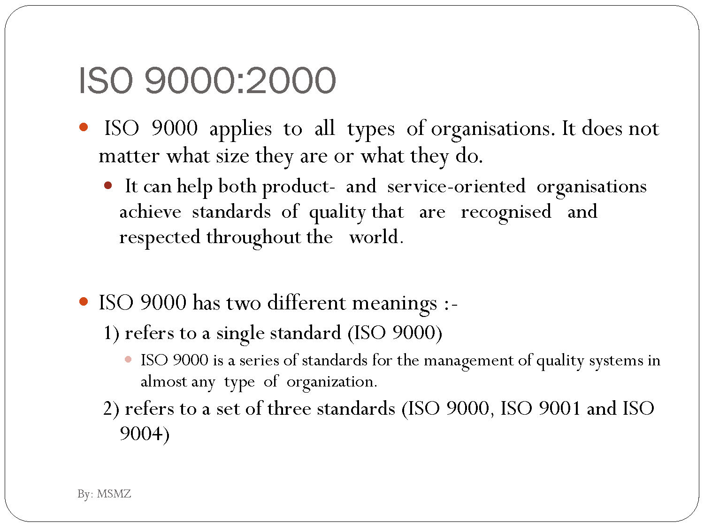

Slide 15
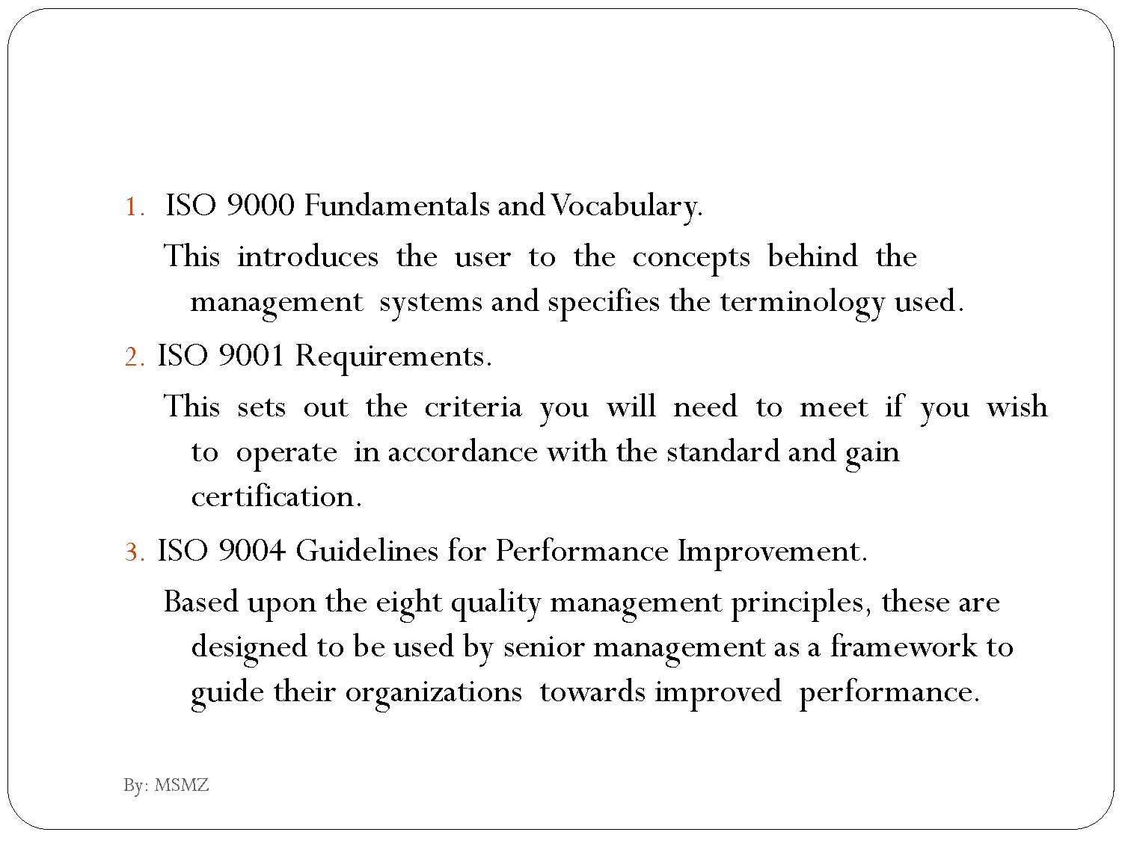

Slide 16
ISO 9000 Series
ISO 9000 (a guide)
ISO 9001 (a set of requirements for the quality system of the supplier)
ISO 9002 (product standards)
ISO 9003 (final inspection and testing)
ISO 9004 (guidelines for developing and implementing quality system principles, structure, auditing and review)

Slide 17
ISO 9000
An entire family of standards
ISO 9000 is also an individual standard
Outlines vocabulary/definitions for entire QMS series
Main purpose - definition

Slide 18
ISO 9001
An individual standard within ISO 9000 family
Includes specific requirements for a company
Gap analysis and internal audits are required
Main purpose - actions

Slide 19
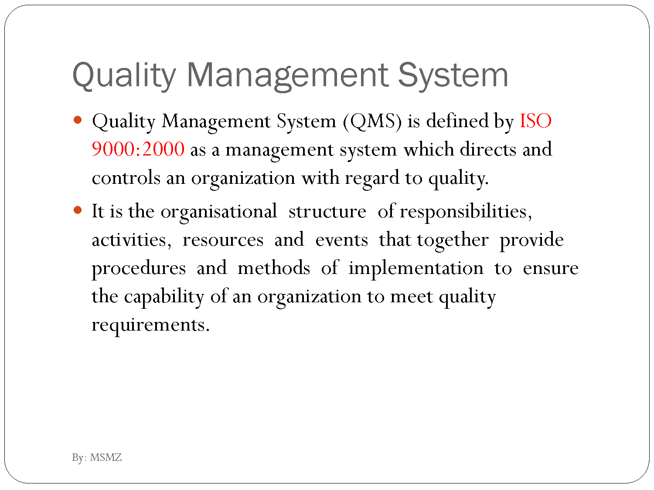

Slide 20
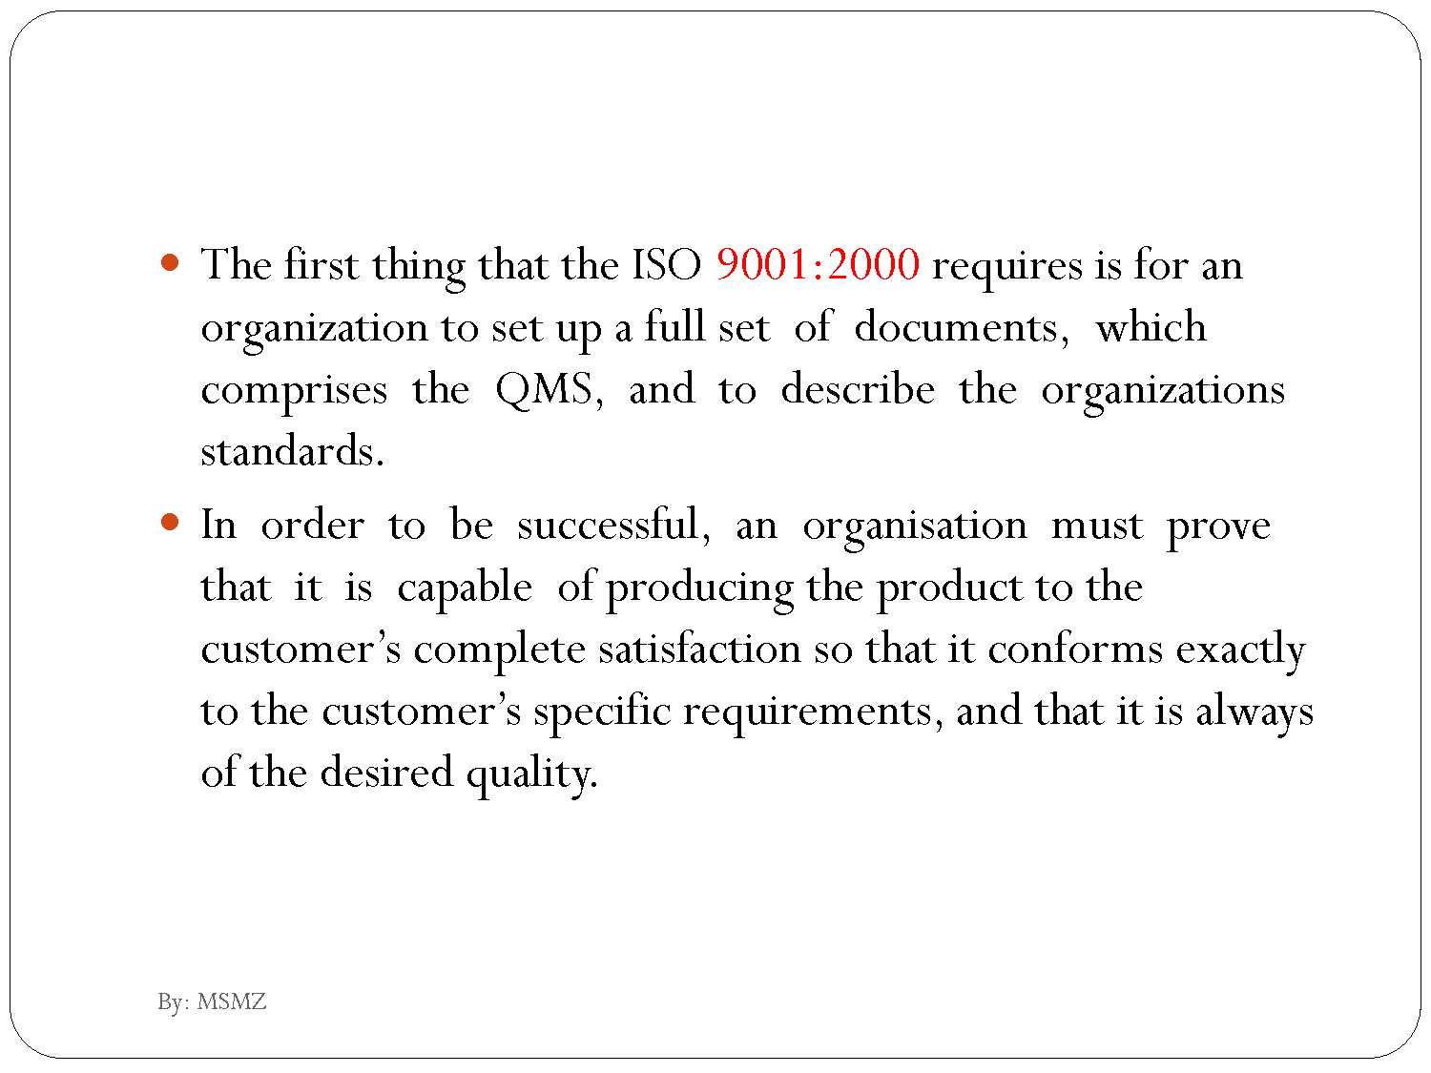

Slide 26
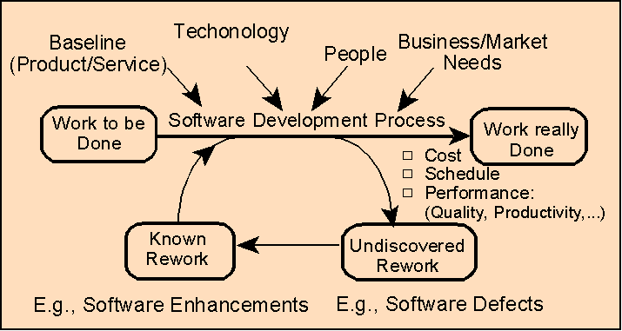
Applicability of ISO 9001 to Software Development
ISO 9001's focus is on all factors except "technology".
ISO 9000-3 provides "guidance" on implementing an ISO 9001 compliant set of processes (QMS)
Guidance is for software development, supply and maintenance environments
Notes:
Scope of ISO 9001:
ISO 9001 is a generic international standard, adopted on a country-by-country basis, and written for use by the widest possible audience. As a result, the standard provides requirements (what needs to be done) and does not issue specific prescriptive solutions (how to do it).
Being so broadly focused, the ISO 9001 standard does not offer details about its application to specific domains of expertise. To assist in the application of the standard for specific domains, a series of guidelines are available; e.g., ISO 9000-3 is a guideline for the software development industry.
Relevance of ISO 9000-3
ISO 9000-3 provides "guidance" on implementing an ISO 9001 compliant set of processes (collectively referred as a "quality system" or as a "quality management system").
ISO 9000-3 is an international guideline. Guidance is for software development, supply and maintenance environments. The guideline is primarily written for "custom" (contract driven) software markets. It can easily be adapted for other market needs such as commercial-off-the-shelf (COTS), internal software development, etc..
ISO 9000-3 virtually mirrors the provision of ISO 9001--it does not add to, or otherwise change, the requirements of ISO 9001.
ISO 9000-3 is not intended to be used as an internal/external audit tool. Its intent is to guide software organizations with their ISO 9001 implementation and process change efforts: in short, software organizations are audited against ISO 9001 (not ISO 9000-3).

Slide 27
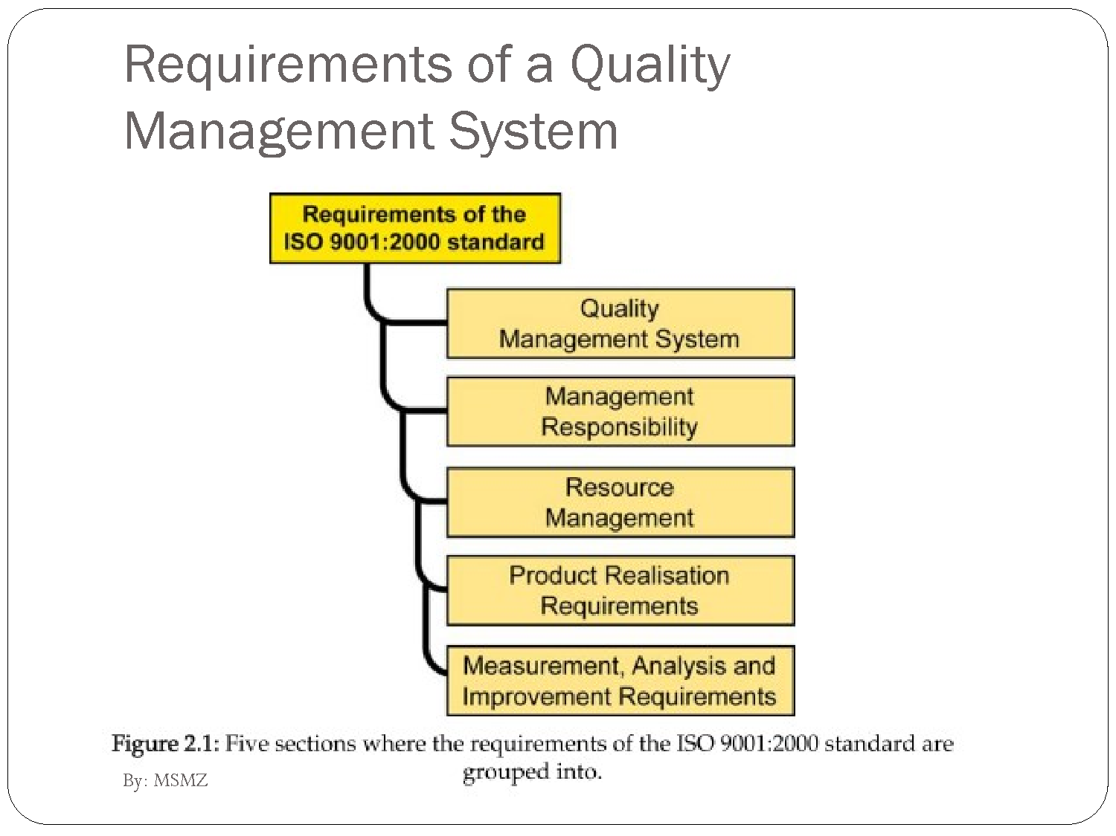

Slide 28
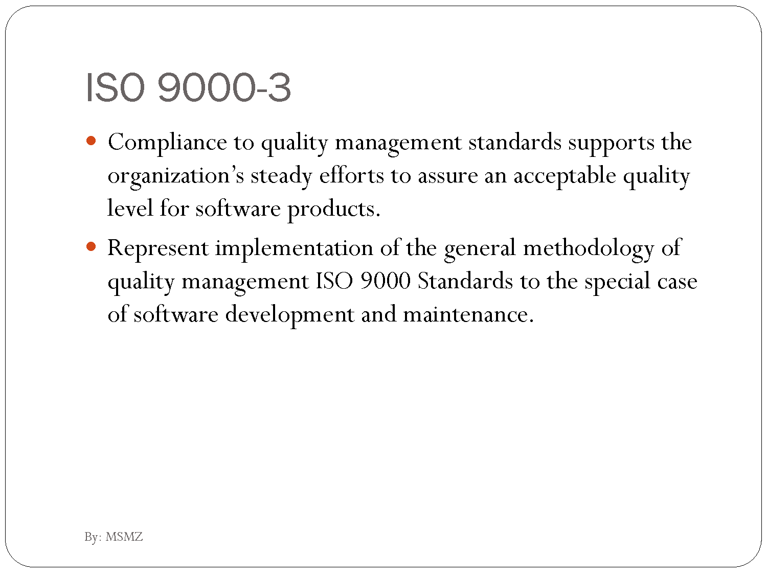

Slide 29
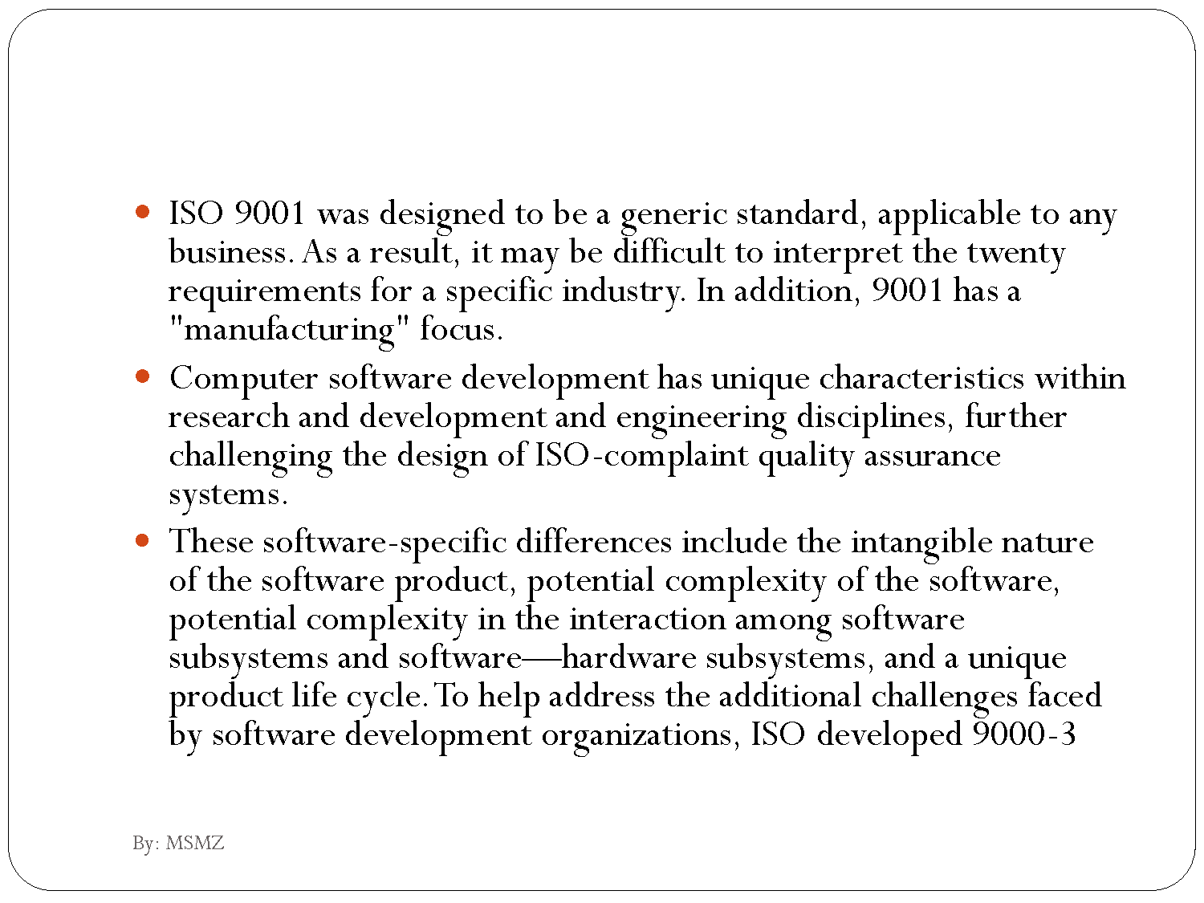

Slide 30
ISO 9000 history and revisions: ISO 9000:2000, 2008, and 2015
ISO 9000 was first published in 1987 by the International Organization for Standardization (ISO), a specialized international agency for standardization composed of the national standards bodies of more than 160 countries. The standards underwent major revisions in 2000 and 2008. The most recent versions of the standard, ISO 9000:2015 and ISO 9001:2015, were published in September 2015.

Slide 31
ISO 9000:2000
The ISO 9000:2000 revision had five goals:
Meet stakeholder needs
Be usable by all sizes of organizations
Be usable by all sectors
Be simple and clearly understood
Connect quality management system to business processes
ISO 9000:2000 was again updated in 2008 and 2015. ISO 9000:2015 is the most current version

Slide 32
ISO 9000:2015 principles of Quality Management
The ISO 9000:2015 and ISO 9001:2015 standards are based on seven quality management principles that senior management can apply to promote organizational improvement.

Slide 33
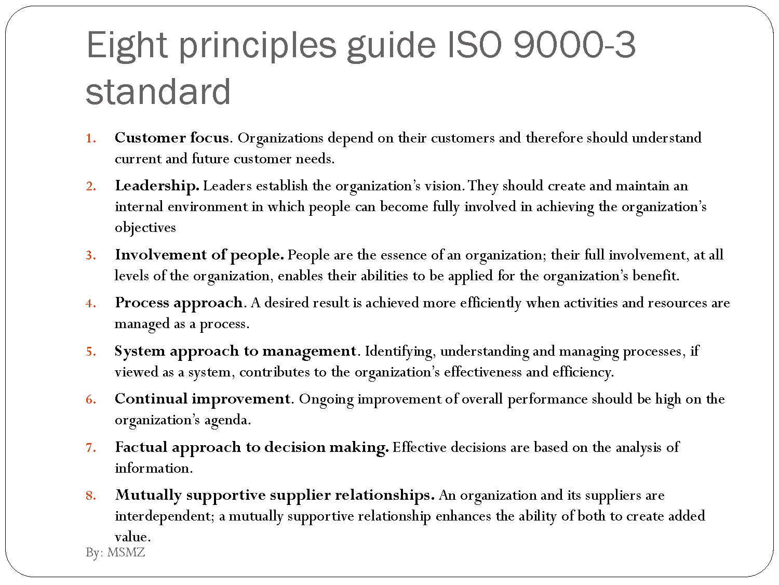

Slide 34
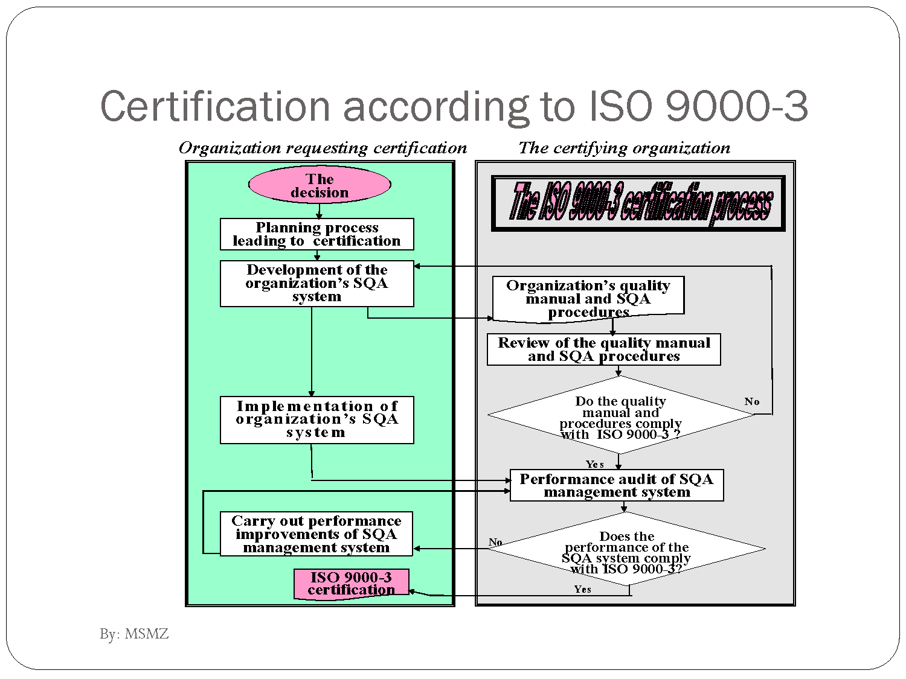

Slide 35
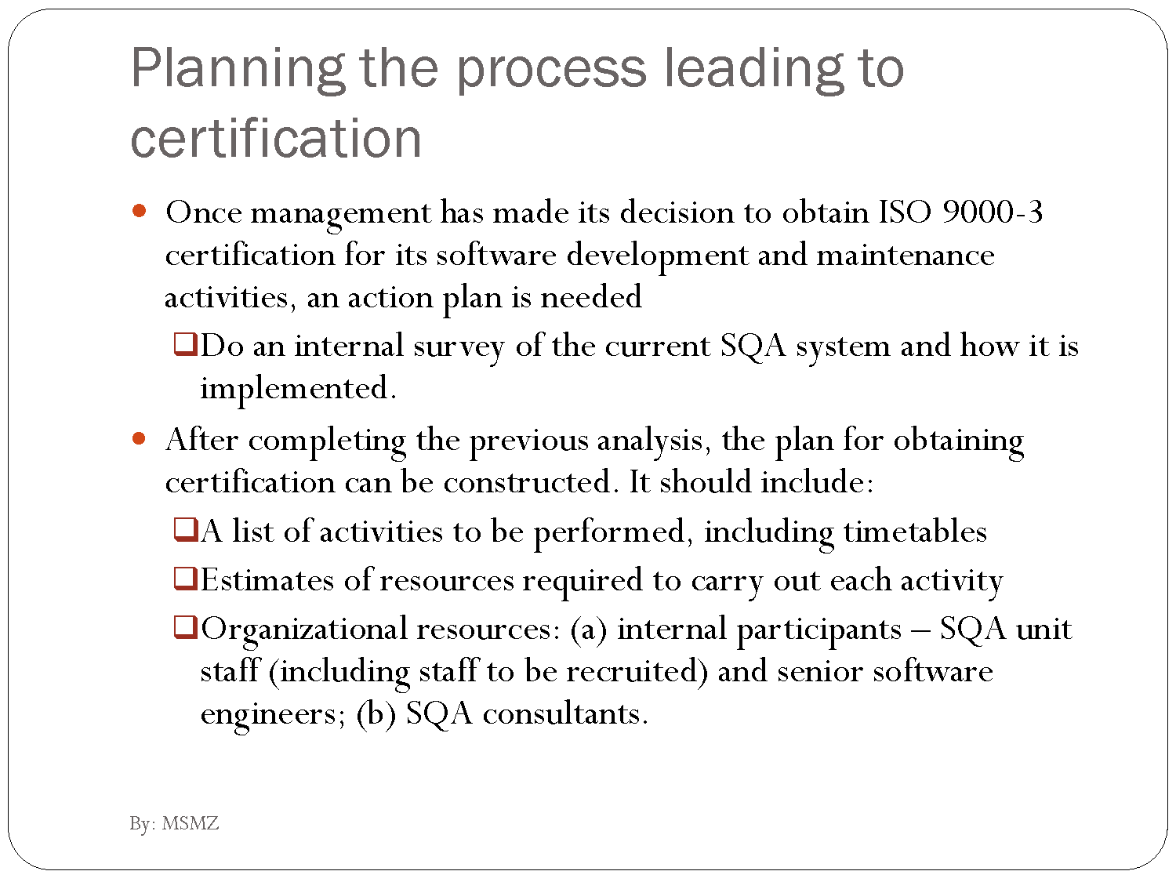

Slide 36
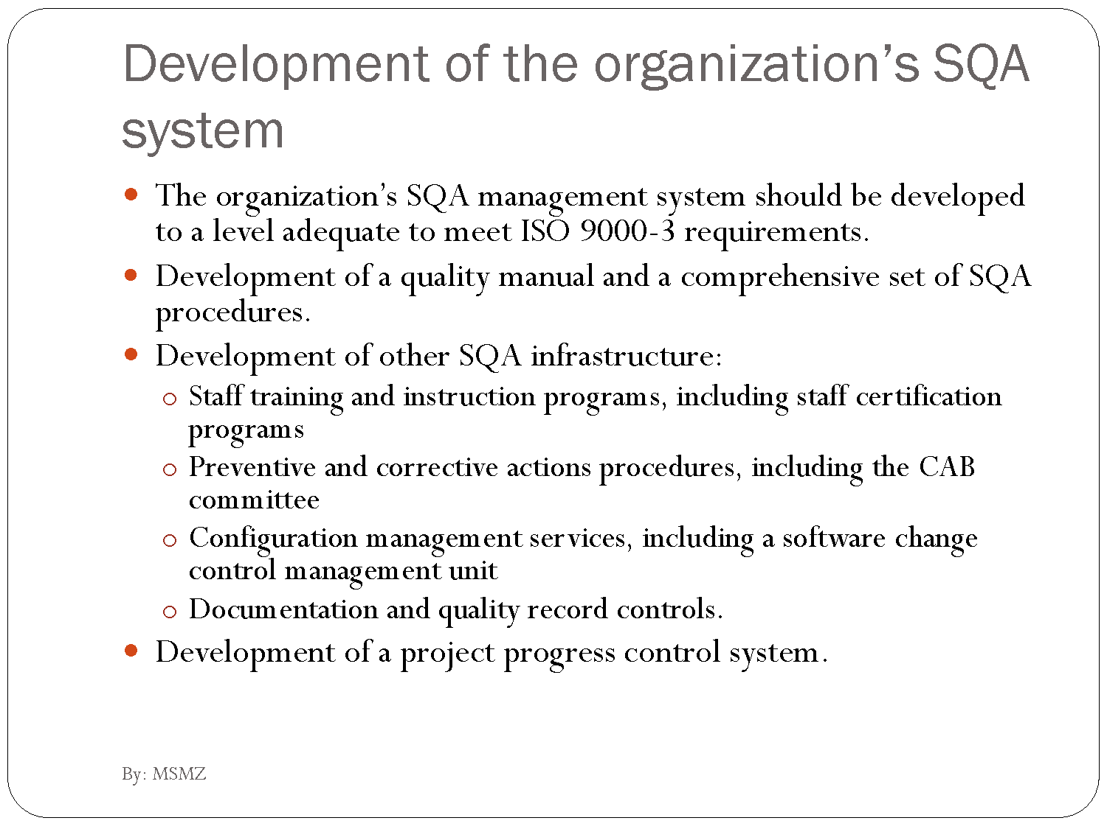

Slide 37
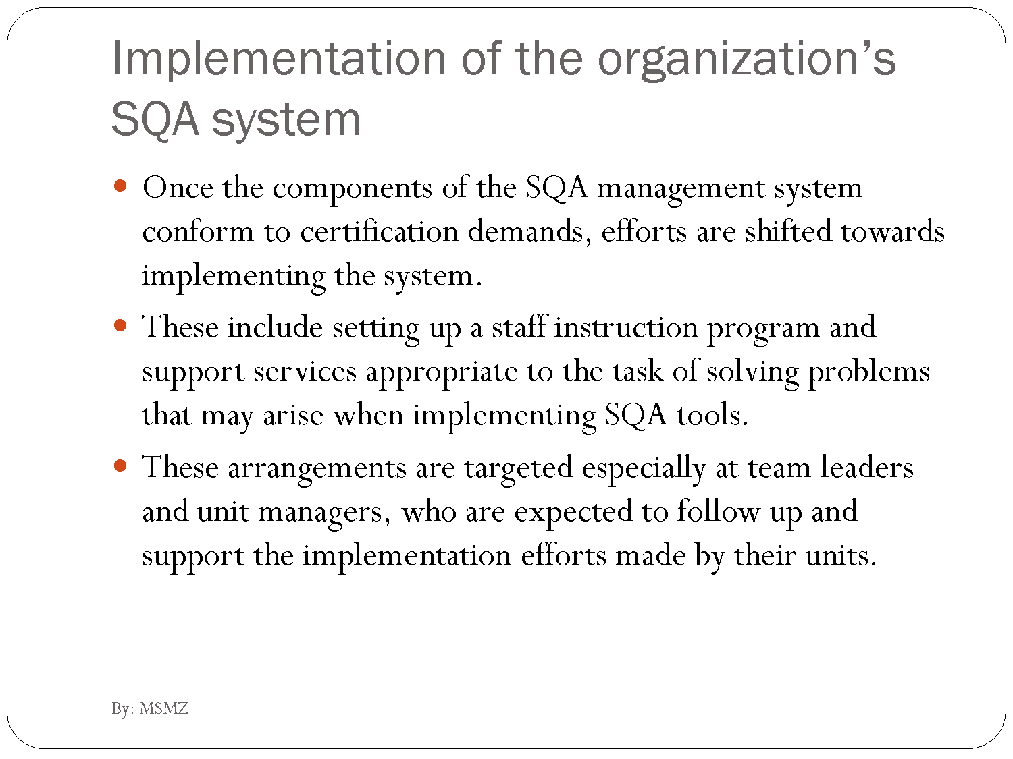

Slide 38
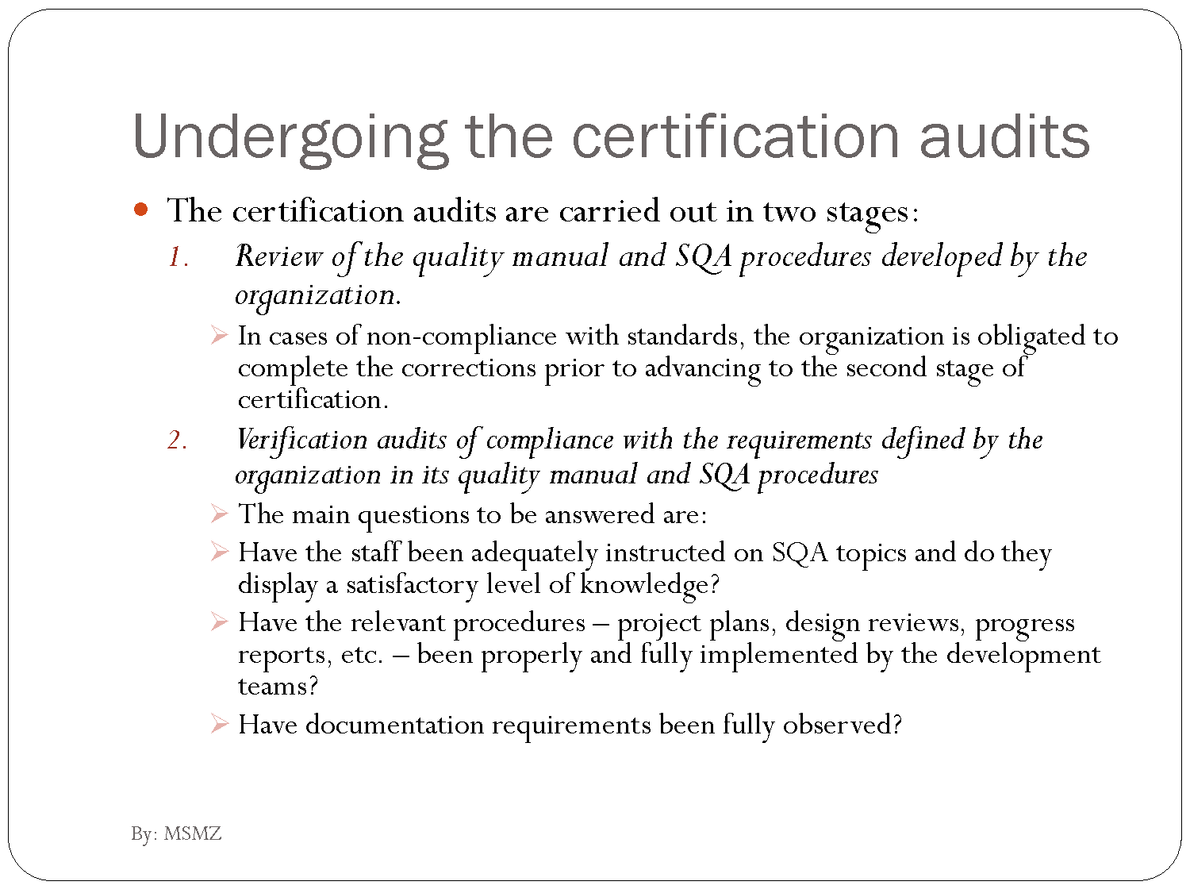

Slide 39
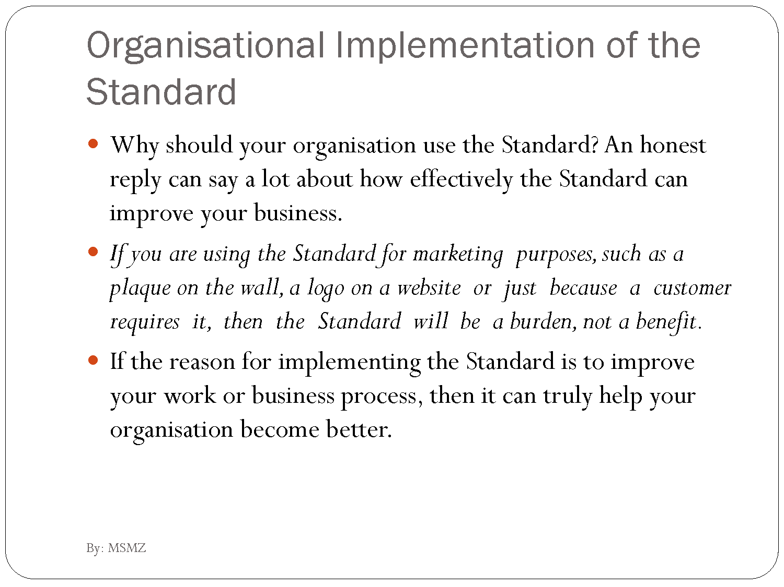

Slide 40
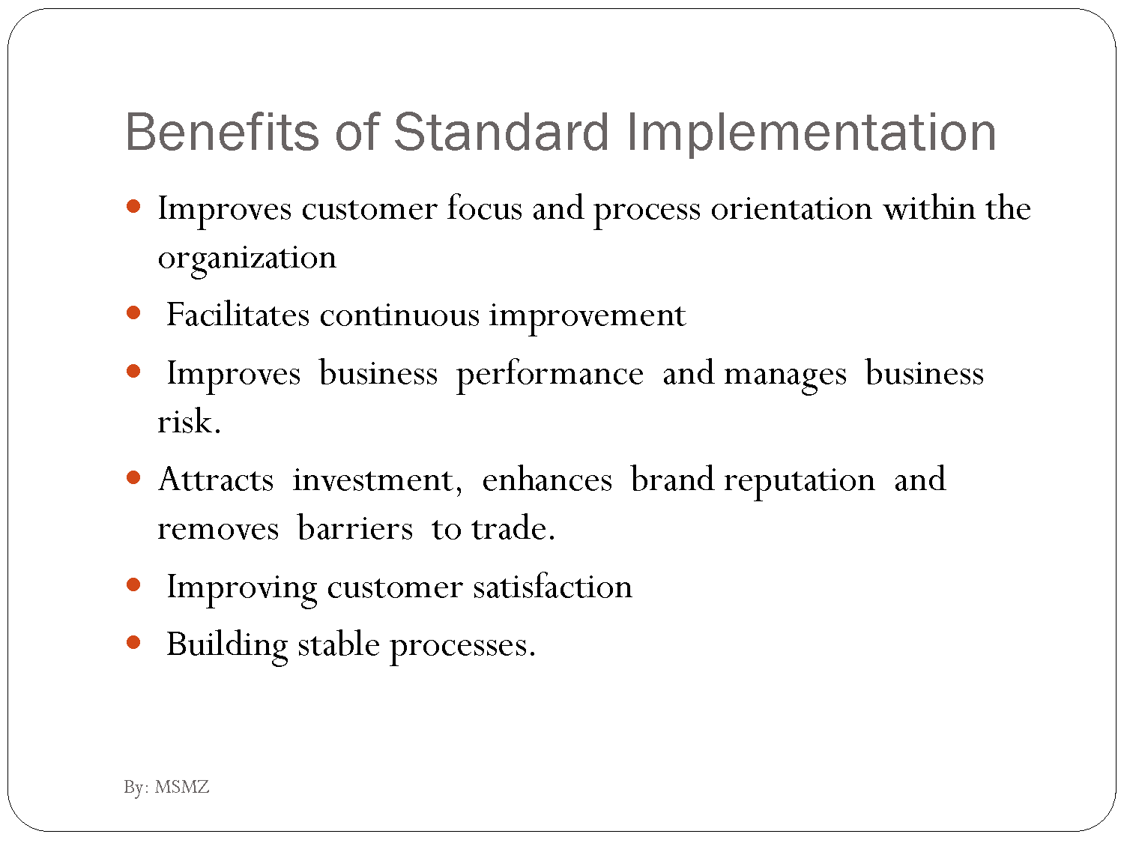

Slide 41
Capability Maturity model
Role of SQA in software development maturity- Six Sigma Concepts

Slide 42
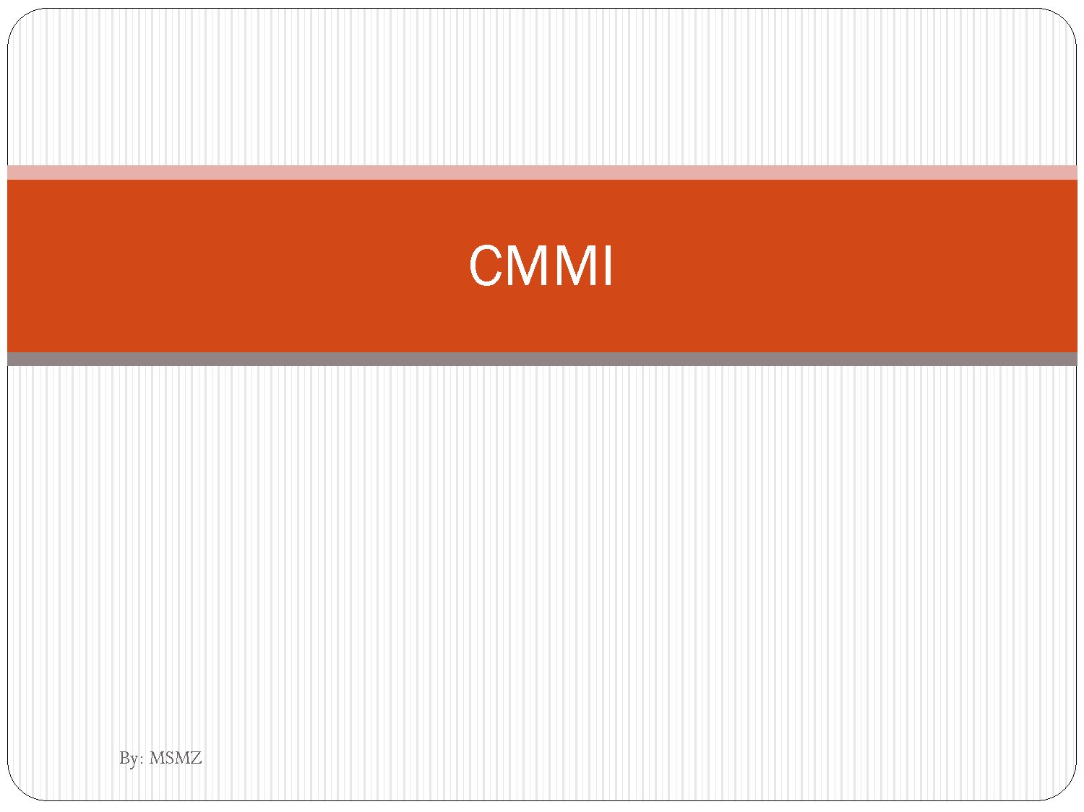

Slide 43
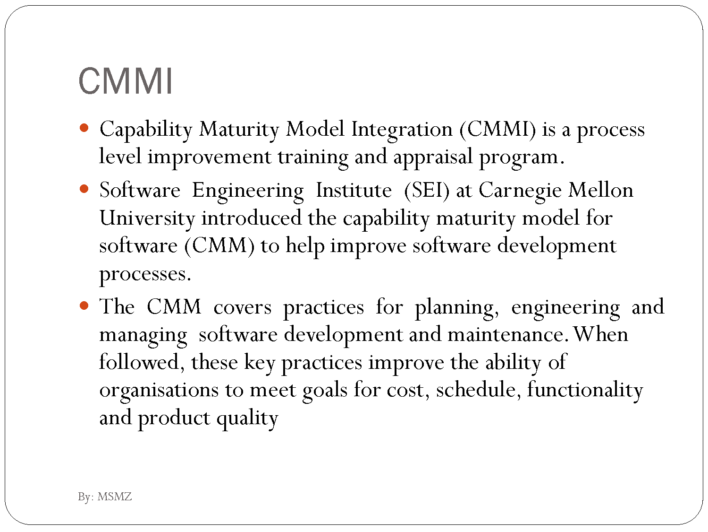

Slide 44
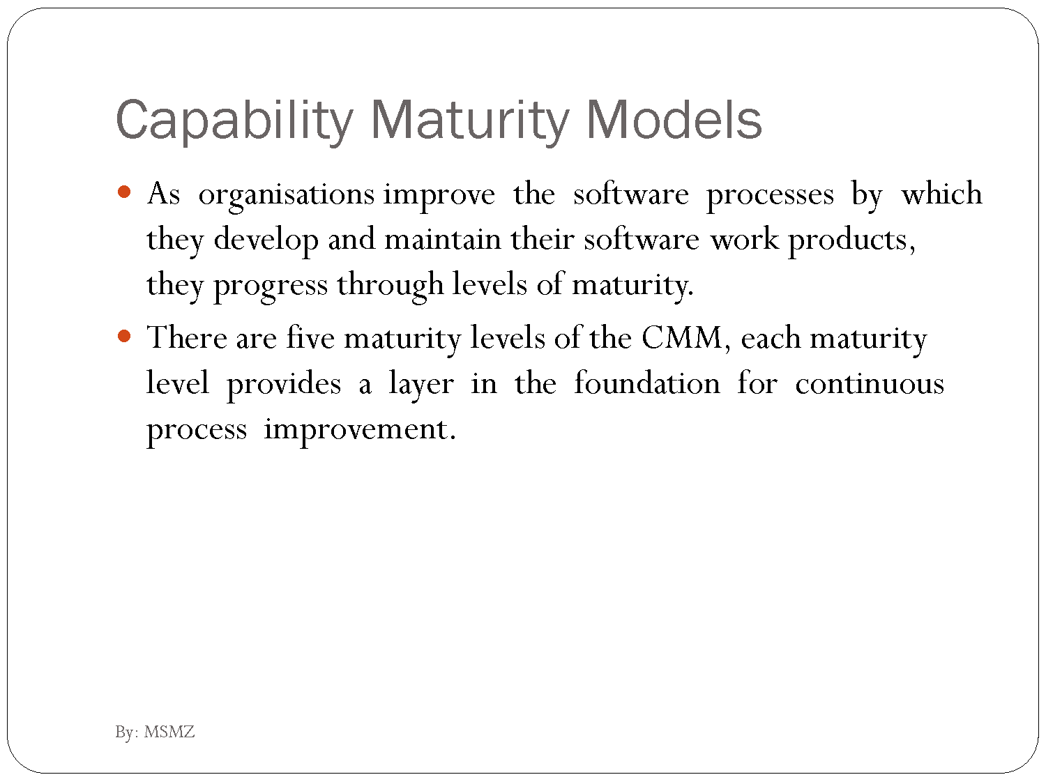

Slide 45
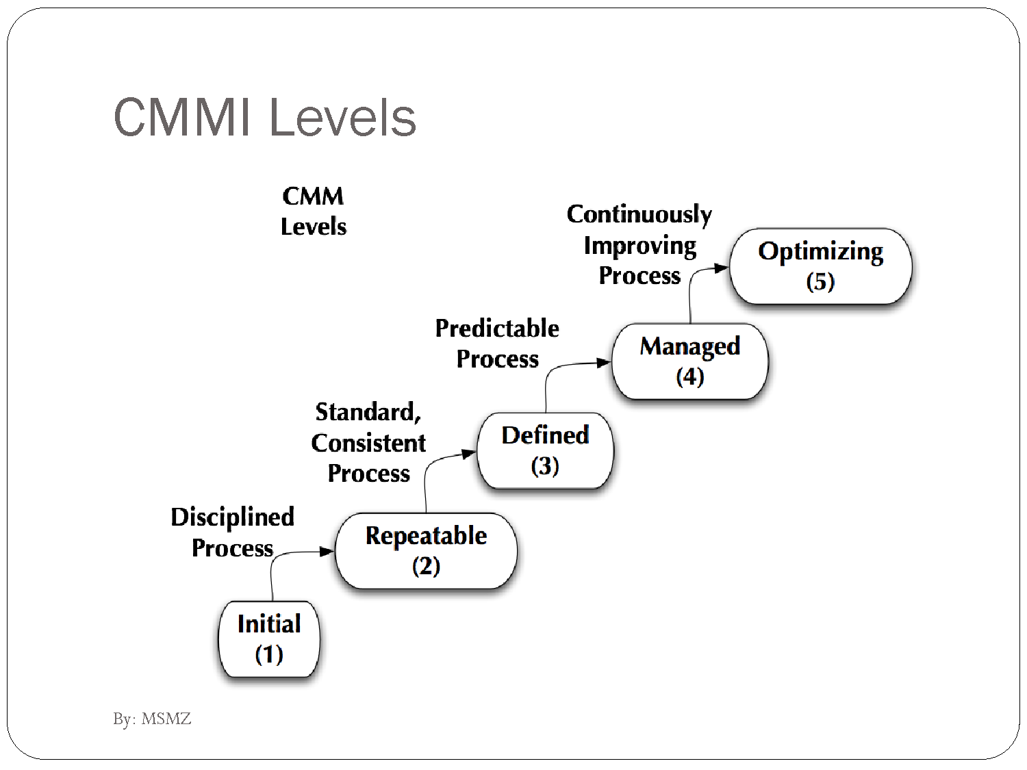

Slide 46
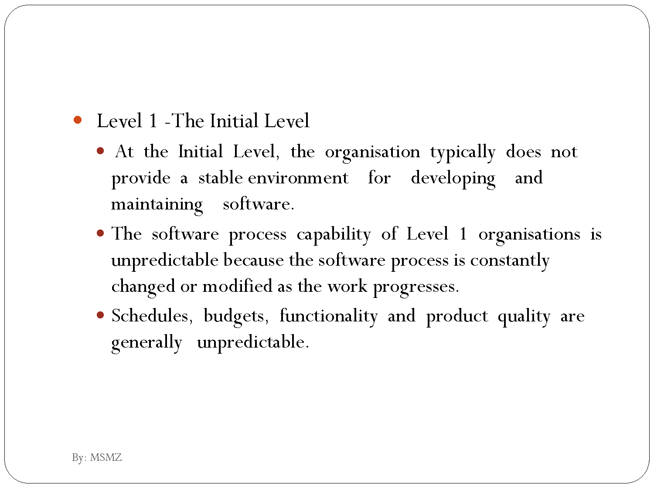

Slide 47
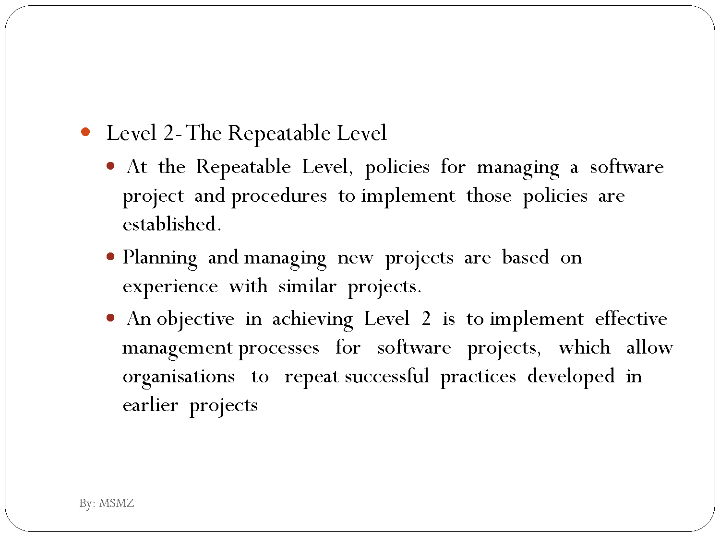

Slide 48
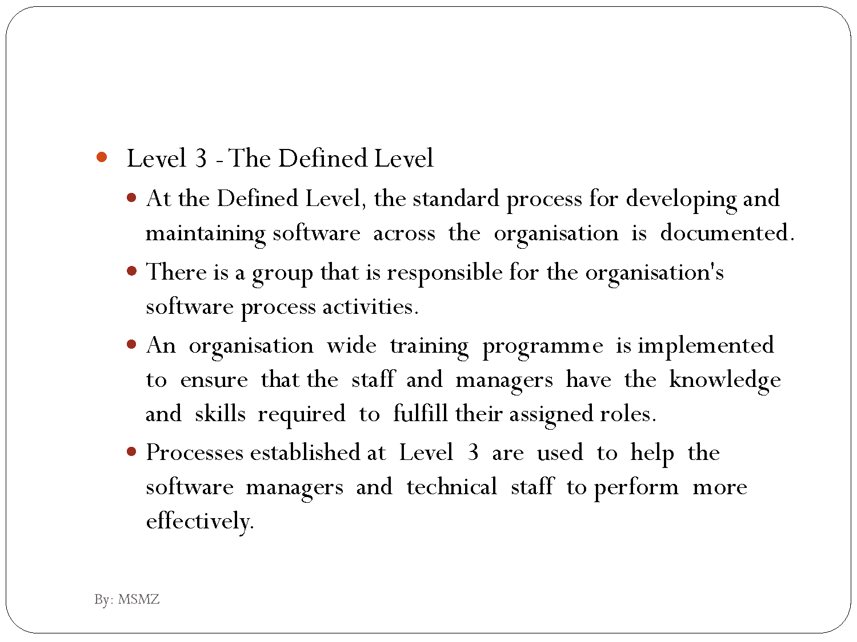

Slide 49
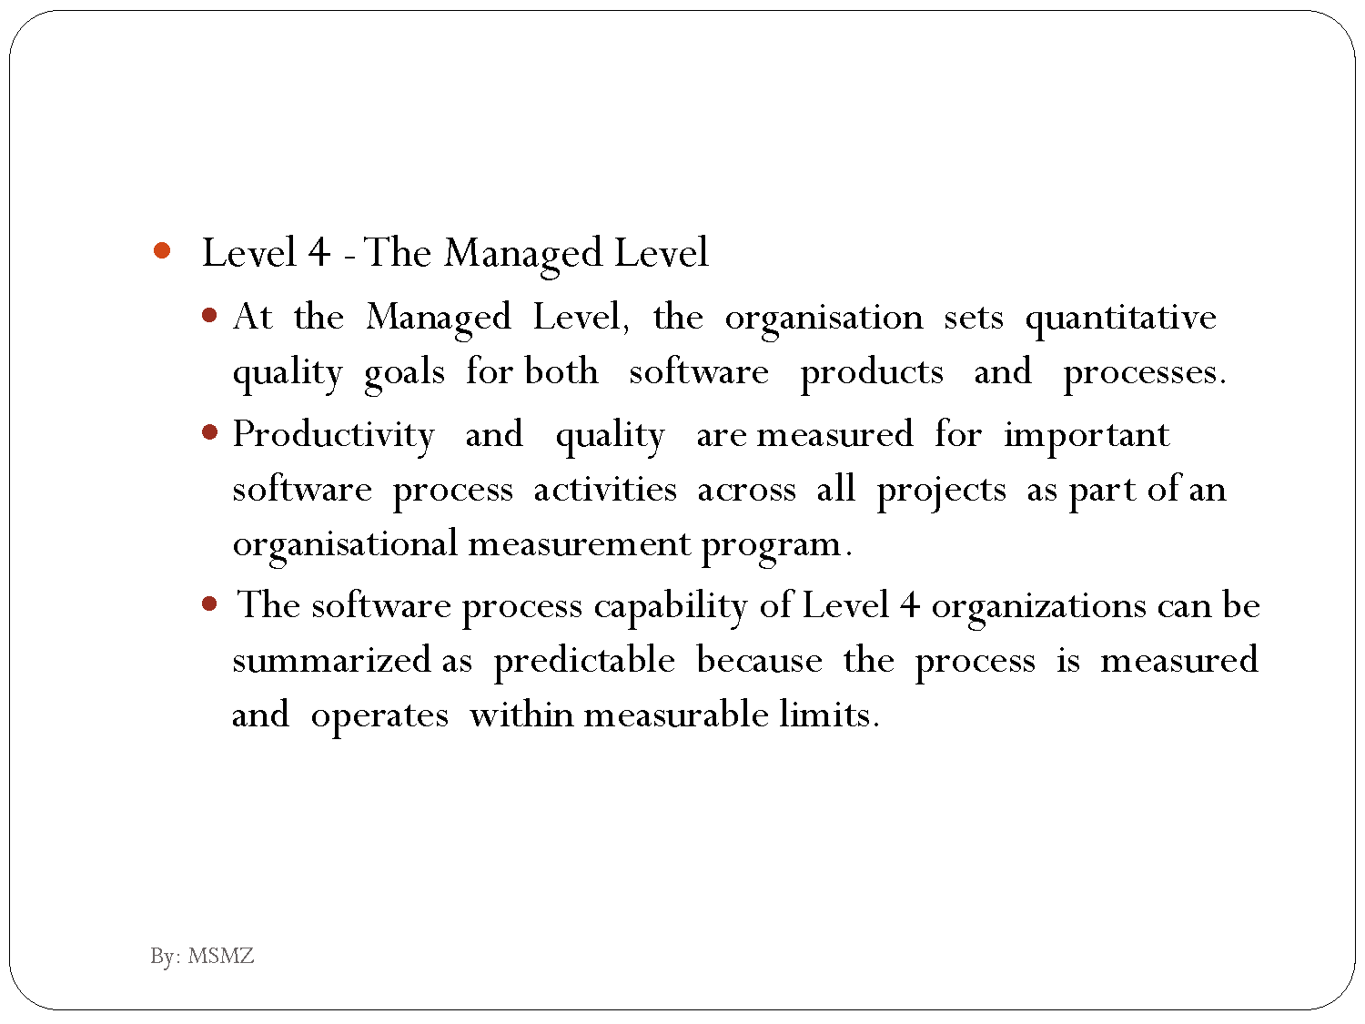

Slide 50
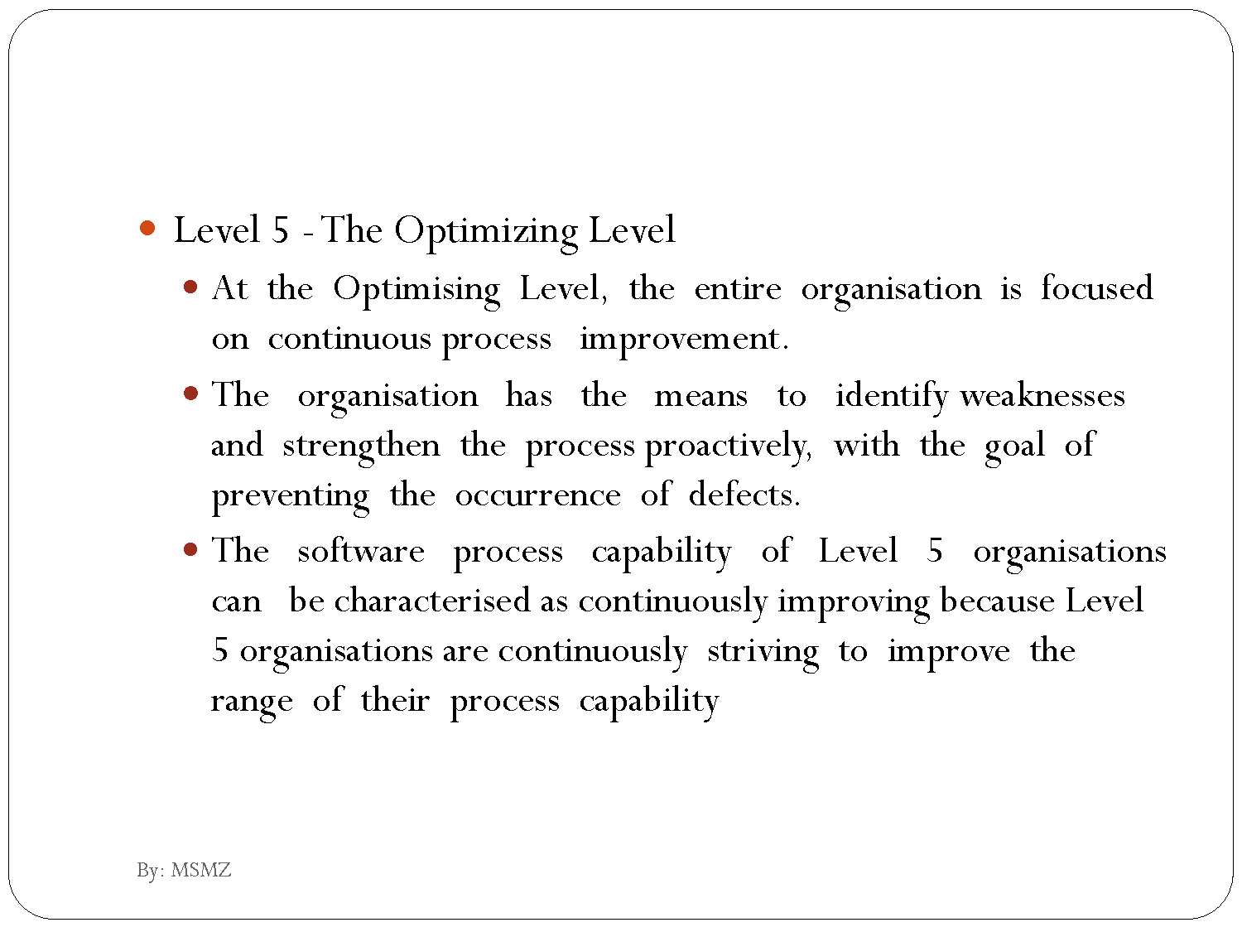

Slide 51
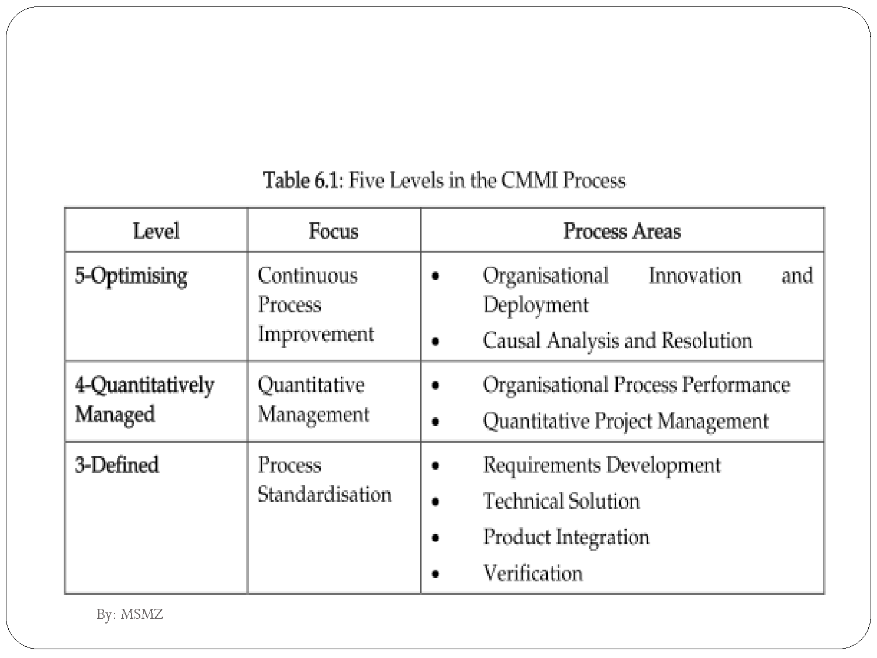

Slide 52
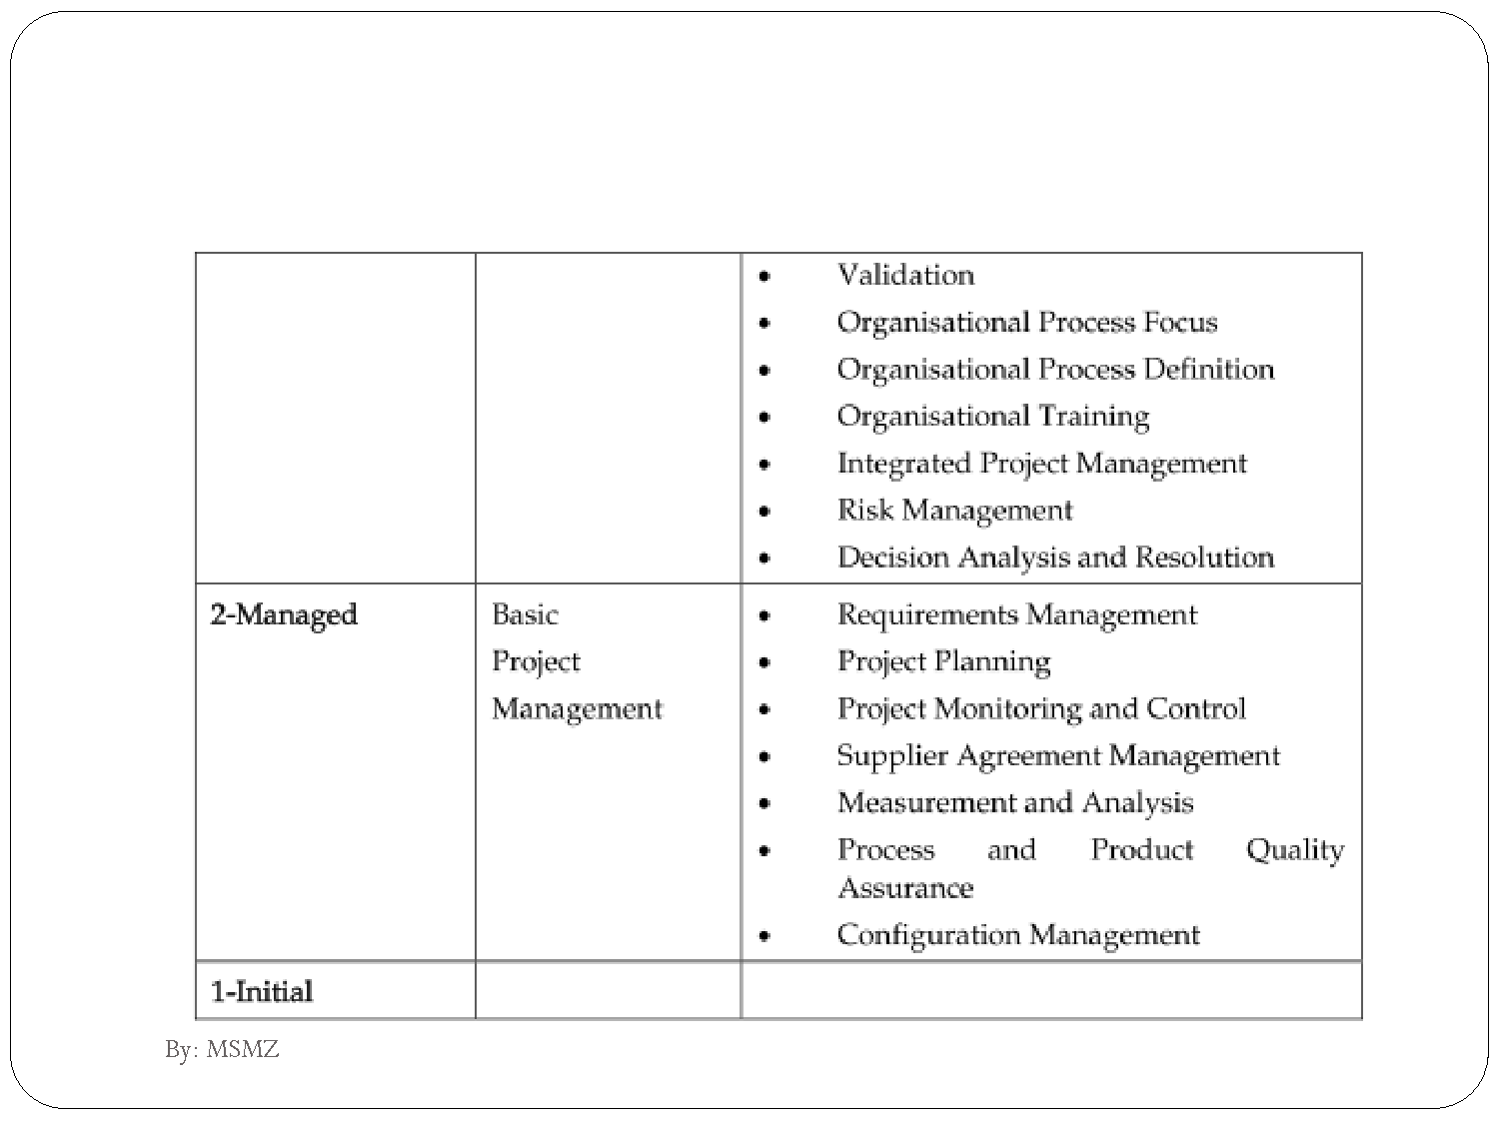

Slide 53
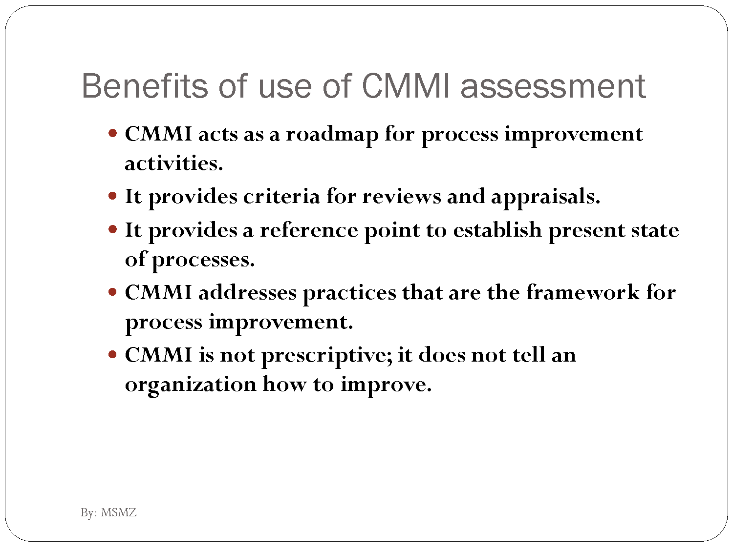

Slide 54
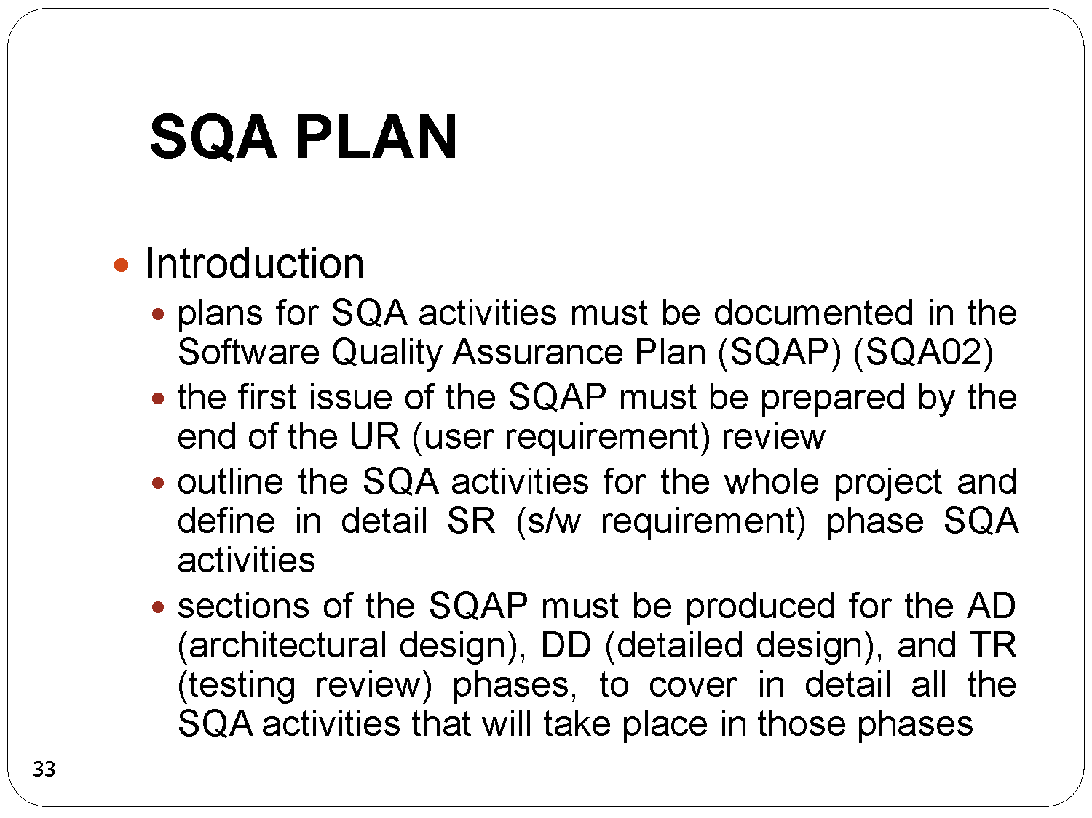

Slide 55
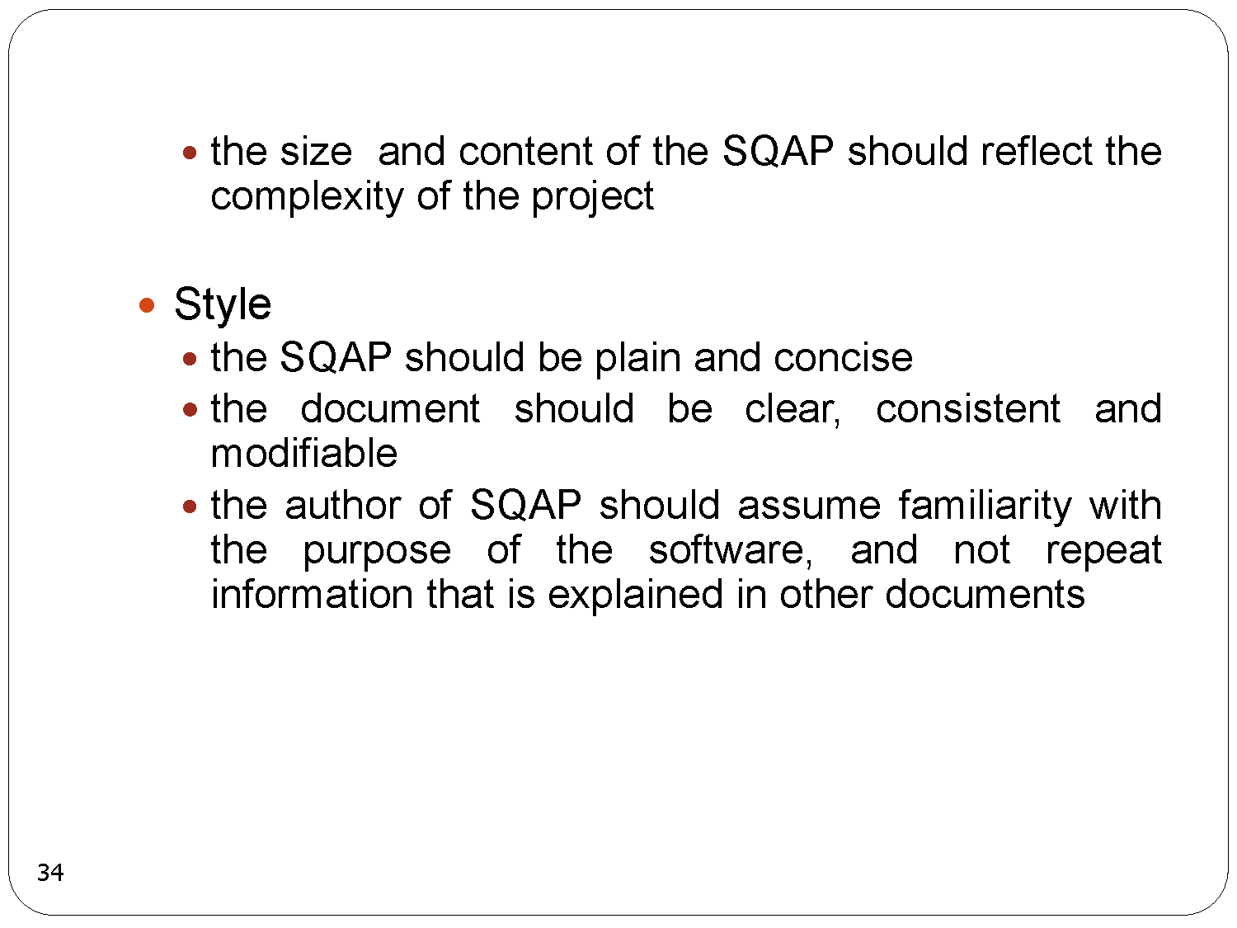

Slide 56
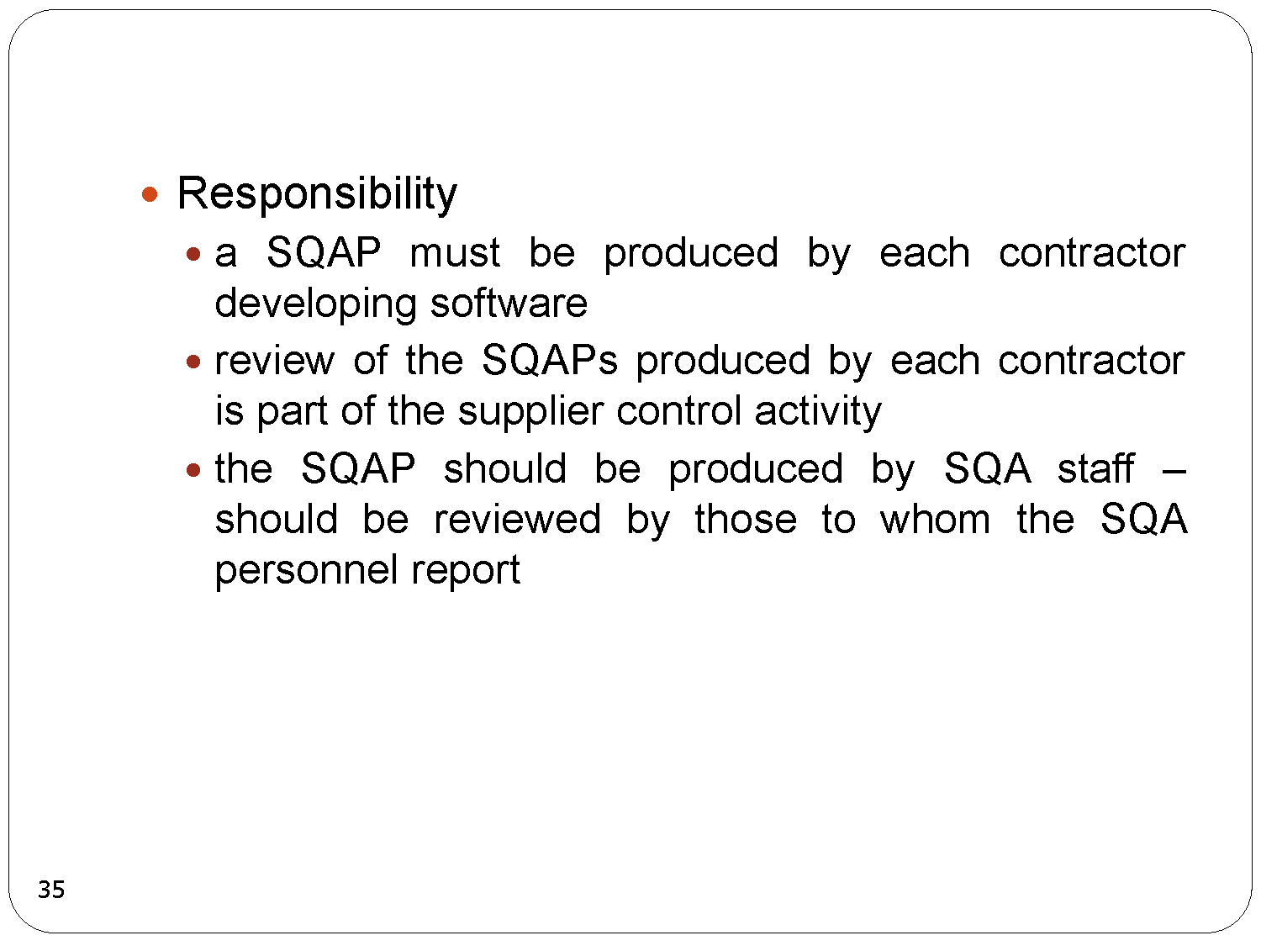

Slide 57
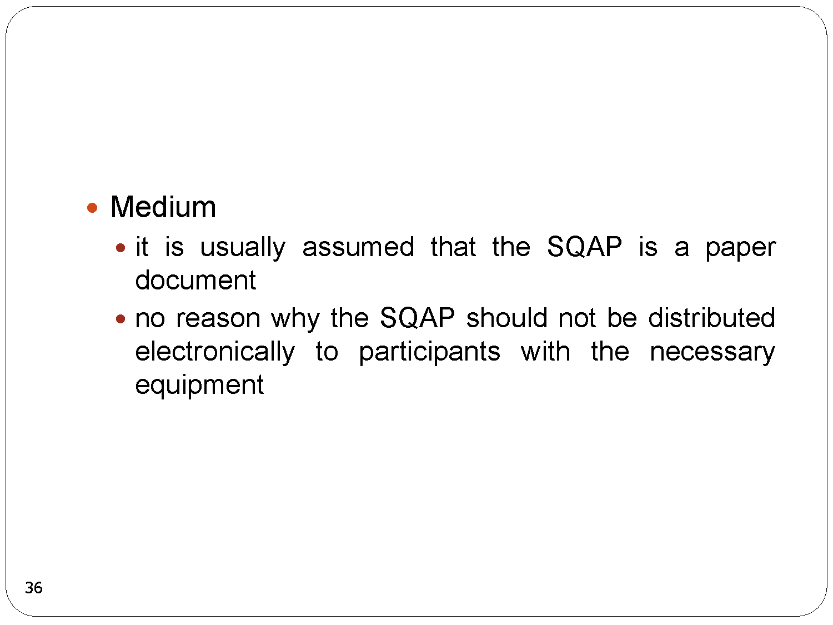

Slide 58
